Slide 1
IEEE 802 Tutorial:
Video over 802.11
Presenters:
Ganesh Venkatesan (Intel)
Alex Ashley (NDS)
Ed Reuss (Plantronics)
Todor Cooklev (Hitachi)

Slide 2
Contributors
Ganesh Venkatesan, Intel Corporation
Alex Ashley, NDS Ltd.
Ed Reuss, Plantronics
Yongho Seok, LG Electronics
Youjin Kim, ETRI
Emre Gunduzhan, Nortel
Harkirat Singh, Samsung
Todor Cooklev, Hitachi America Ltd.
Sudhanshu Gaur, Hitachi America Ltd.
Graham Smith, DSP Group
Joe Kwak, InterDigital
Don Schultz, Boeing
Paul Feinberg, Sony

Slide 3
OUTLINE
Motivation.
  Why? - Use Cases
Challenges.
  What? - Video and its characteristics
  How? - current 802.11 mechanisms
Further work
  Limitations in the current 802.11 mechanisms
  Possible areas of work
  Activities outside 802.11
Conclusions
Notes:
Why are we doing this? – use cases. TV is available in almost every home (unlike Internet access!)
What is that problem? – video
How? – current and envisioned 802.11 mechanisms.
Needs to keep working in densely populated areas

Slide 4
Motivation: Use Cases
Flexibility of not having to deal with wires is a compelling reason to use 802.11 for video streaming
Video Streaming encompasses a broad range of use cases
This tutorial will focus on a subset of use cases
Solutions to improve performance for use cases at one end of the spectrum may not be effective to those at the other end
Notes:
Streaming is a broad problem. What will be our focus – short-term and long-term?
What would be the focus of the tutorial today?
A few cases not addressed here are specified in “Other Challenges”

Slide 5
Use case dimensions
Uncompressed or Compressed*
Unicast, Simulcast, Simulcast w/data, Multicast or Broadcast
Low resolution, standard definition, High Definition, studio quality
Resource considerations at the renderer (power, CPU, memory)
Source from Storage (DVD), realtime, Interactive, time-shifted content, location-shifted content
Dense versus Sparse video networks
Audio/Video rendered on the same device or Audio is rendered at speaker(s) wirelessly connected to the video renderer.
DRM (content encrypted) or no-DRM (content unencrypted)
* Uses Cases of interest in the tutorial
Notes:
This is not a complete list. This however, highlights the fact that video streaming is a set of problems. In some cases 802.11 just does not have the capacity (uncompressed video, for instance)
By HD we mean vertical video resolutions 720p, 1080i or 1080p.

Slide 6
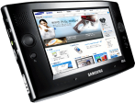


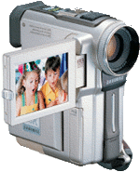
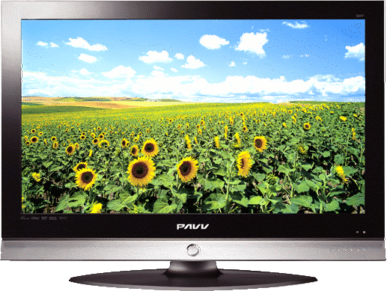



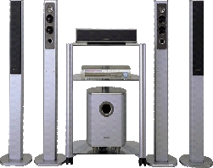


Use Cases
PMP
Camcorder
Digital camera
Home PC
DTV
Wireless AP
(Internet gateway)
Projector
Home theater
(AV receiver)
STB (Cable TV access)
DVD player
Many applications including …
  Delivering multiple HD streams to several receivers
  Displaying stored digital contents from media servers to display devices
  Browsing contents in distributed devices through big screen TVs
Notes:
Source/destination not necessarily in line-of-sight, source/destination may not be in radio range (so an AP may be needed to extend the range)
This is another way of describing what we have in the previous slide – recommend deleting the previous slide

Slide 7
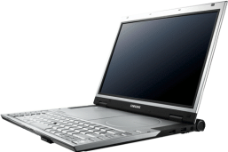

Use Cases: Multicast
Content server multicasts multimedia streams to many authenticated users.
Regardless of how many users receive the streams, a single WLAN channel is expected to be used.
Content server can be STB, PC, AP, or even any portable devices.
Laptop PC
PMP
PMP
Laptop PC
AP
Home PC
PMP
STB (Cable TV access)
PMP
Notes:
Multicast is a difficult problem and is a less common usage model in the home environment. However, with the proliferation of Wi-Fi, it could become an important case. Hence the to study this case in detail and explore the solution space.
Discuss the need for multicast – (mention that we do not intend to cover mobility/roaming related issues in the tutorial)
simulcast?
watch the same content from different rooms

Slide 8
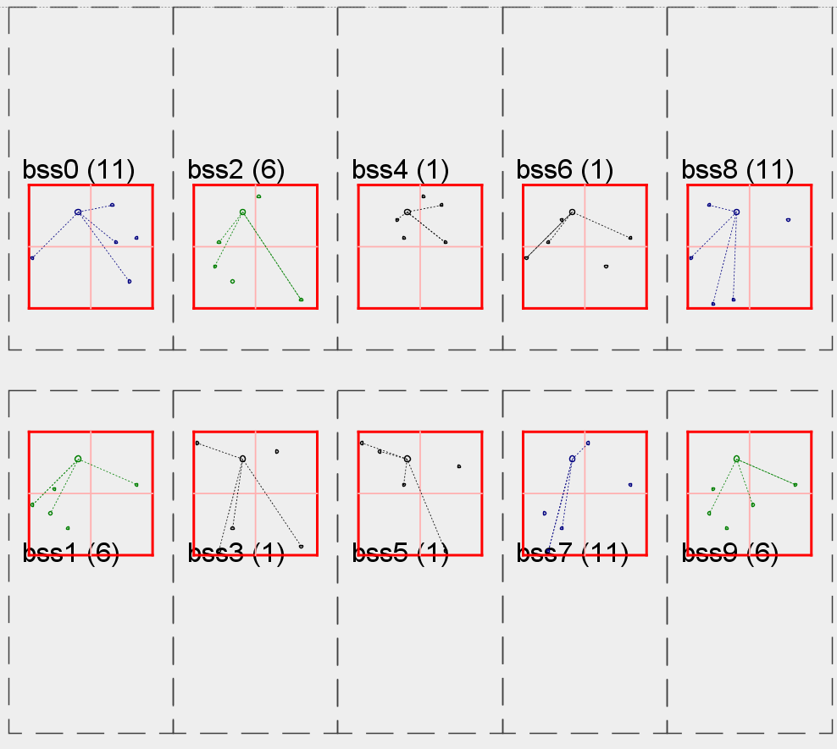
Use Case: Row of Houses
Brick construction
2 Compressed Audio/Video Streams
  HD or SD
Typically two hops per stream
  AP possibly in different room
Additional bandwidth for one voice call and moderate data traffic
  Random bursty BE traffic
Notes:
Dense dwelling
Degradation due to interference highly probable in these environments
A problem with 2.4GHz band (limited channels)
Is 3.5 Mbps just an example? What is CBR?

Slide 9
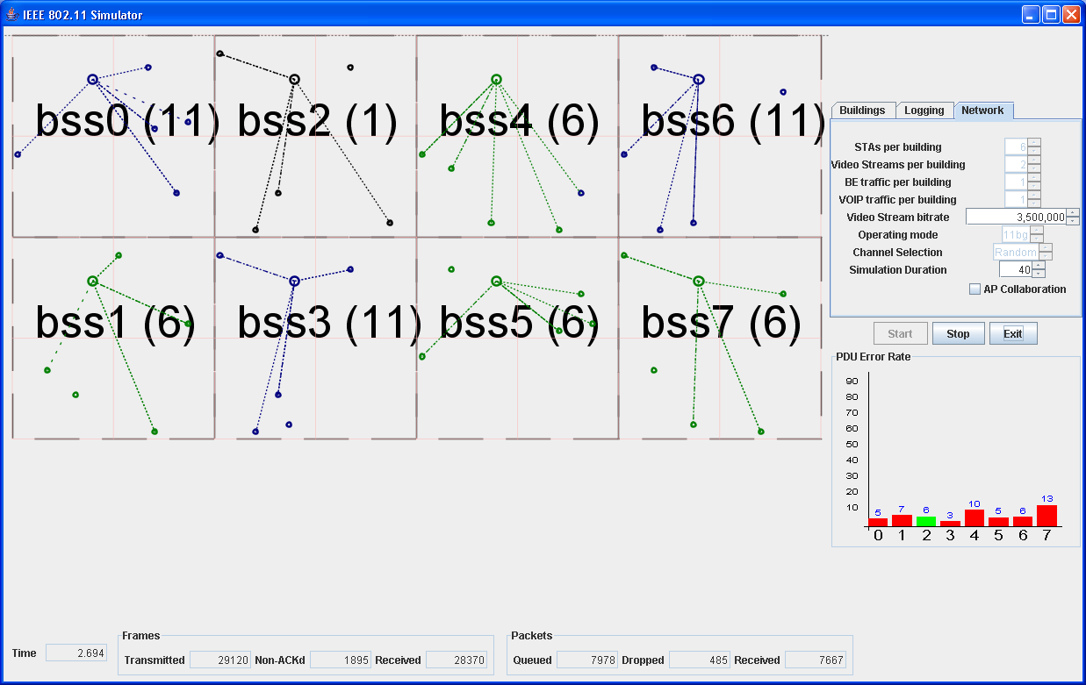
Use Case: Multiple Occupancy Dwelling
Apartments in a high-rise setup
  Brick outer construction, concrete floors, drywall inner
2 SD Audio/Video Streams or 1 HD stream
Typically two hops per stream
Additional bandwidth for one voice call and moderate data traffic
Notes:
Our analysis is that larger homes closely packed together is the worst case, but everyone intuitively thinks that a block of flats is the worst case.

Slide 10
The usage model for TV is very different from the usage model for the Internet
94 %
TVs are viewed typically for longer hours per day
Video over wireless experience should be comparable to the current experience over ‘wired’ connection(s)
From – The challenges for Broadcast Television over Wireless in-home networks, Alex Asley and Ray Taylor, NDS Ltd. U.K.
8 hours
66 %
Percentage of homes
Hours per day
42%
USA
33 minutes
Ireland
Television
Internet
Notes:
If we want to use wireless technologies within the home, we need to consider the expected usage pattern. If we compare television usage with Internet usage we find their usage in to the home to be very different. Based on research from the US I have found figures for average hours per day at home spent watching TV and using the Internet. As we can see there is a huge difference between them. This can partly be explained by the fact that television viewing can be a passive experience that can be combined with other activities such as eating a meal, doing the ironing. In some households the television is “wallpaper” that is left on almost all of the time. Internet usage on the other hand is rarely a passive experience and is not normally multi-tasked. The next statistic to consider is percentage of homes with at least one TV and the number of homes with Internet access. Television is almost ubiquitous in Western Europe and the US. Internet access is more variable, for example in Western Europe it varies between 42% and 66%. The UK for example has 60% of UK homes with Internet access (Ofcom 2006 figures).
Alex’s clarification – Video streaming over wireless to TVs does not scale well from wireless communication to a PC – PC’s are used less, people are used to viewing flawless video on TVs (and hence less tolerant to flaws) and there are lot more TVs than PCs (if all TVs were made wireless capable, it would be hard to deal with)
-- People are used to ‘high quality’ video on their TVs. So, video over wi-fi should do as much or better
-- There are more TVs than PC (in general) at homes and TVs are used more (longer hours of use)
-- Since there are more TVs (avg US home has 3 TVs), there could be as many as 3 different sources
-- As HDTV prices drop, all streams will be HD (need more bandwidth, need to use existing bandwidth efficiently)

Slide 11
Use Cases – Typical Requirements
Throughput | ~100 Mbps
Range | ~15 meters with up to 3 walls
Audio | 2 Audio MP3 stereo streams (128kbps)
Video | 2 HD-Video
Remote Gaming | HD-Video stream replaced by 1 Remote Gaming (30 Mbps)
Video/Voice calls (simultaneous) | 2 VoIP calls (95 Kbps) 1 Video IP Phone (384 Kbps)
IP Data | 1 Mbps
Interference | Some co-channel/adjacent channel interference
Notes:
Mention that these are ball park numbers to be used as an example for discussion (and not hard requirements).

Slide 12
Motivation for video over 802.11
The number of homes with TV is greater than the number of homes with Internet
The average US home has 3 TVs
802.11 must work when every home is simultaneously using their network
People are used to high-quality video
The potential market is huge

Slide 13
What is video?
Not all bits are created equal
Video Sequence
Group of Pictures (GoP)
Slice
Macroblock
Picture (Frame)
Block (8x8 pixels)
Intra (I) frames, Predicted (P) Frames or Bidirectional (B) Frames.
MPEG-2 typically uses one I-frame followed by 15 P/B frames to make up a GOP.
Notes:
I-Frames or Intra Frames are also independent frames (it does not depend on other frames past or future) and is the first frame in a GOP
P-Frames or Predicted Frames – they refer to the I-Frame but are referred to by B-Frames
B-Frames or Bi-directional Frame – they refer to the I-Frame and one or two P-Frames. B-Frames are not referred to by I/P/B frames. When a B-Frame refers to two P-Frames the second P-Frame can be a future frame (will be received after the B-Frame is received in some cases)

Slide 14
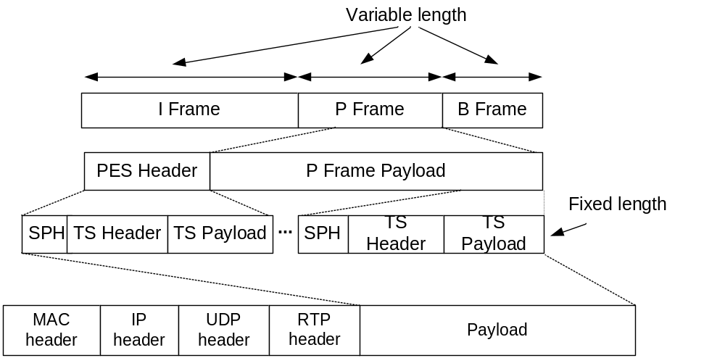
Transport Stream
Notes:
PES – Packetized Elementary Stream, ES – Elementary Stream, SPH – Stream Packet Header (>)
A PES packet may be a fixed (or variable) sized block, with an unlimited size for video data and up to 65536 bytes per PES for other types of payload. Each PES starts with a protocol header that is at least 6 bytes in length. A PES packet is not necessarily aligned with a video frame.
Also mention that this is one possible MPEG-2 transport stream representation.

Slide 15
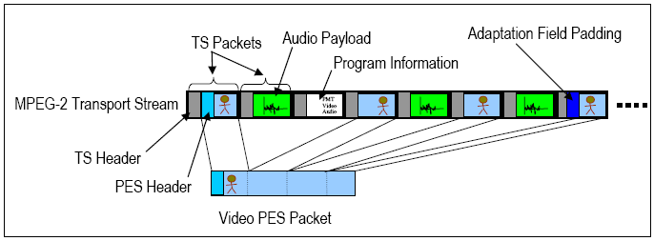
One TS contains audio, video, data
TS Header (4 bytes) has an adaptation field control. This is used among other things to identify the presence of PCR (Program Clock Reference) following the header.
Notes:
A transport stream can contain multiple streams of audio, video and data. For example one satellite transponder transmitting a (modulated) transport stream containing multiple television channels.

Slide 16
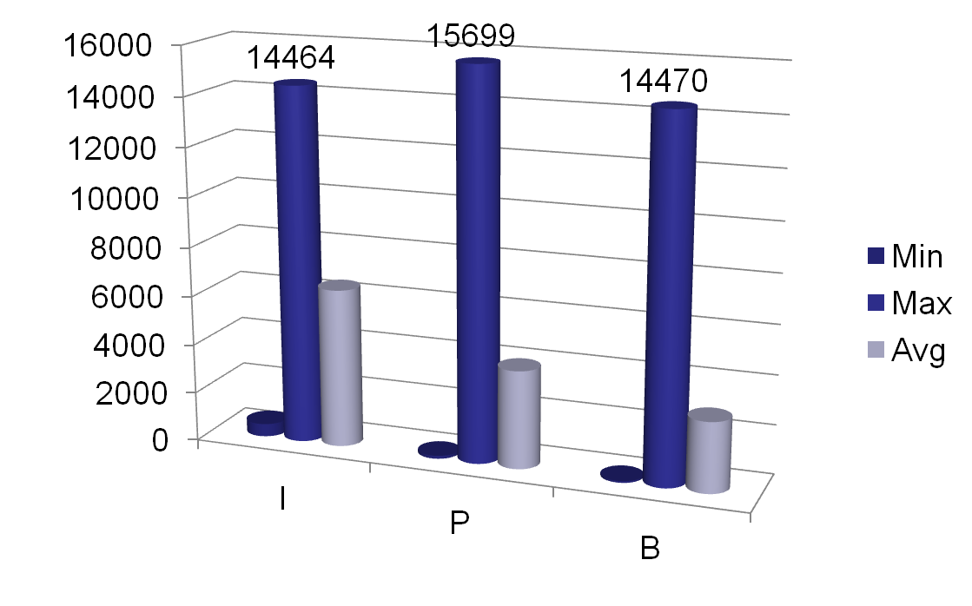
How big are video frames?
Y-axis – frame size in bytes
Notes:
Huge range between min and max – few 10s of bytes to few 10s of kilobytes
This is just an example to illustrate the fact that the size of compressed video frames vary dramatically – causing an 802.11 frame to potentially contain multiple compressed video frames in one case and a compressed video frame span several 802.11 frames in the other.

Slide 17
From video frames to 802.11 packets
Video frames typically span multiple 802.11 packets
TS header may contain PCR – critical for keeping audio/video in sync
  if lost, quality suffers dramatically
The effect of 802.11 packet loss is different depending upon its contents

Slide 18
How are the metrics defined?
Rendered Video Quality Metrics (e.g. Mean Opinion Score)
Network performance Metrics (Packet Loss, End-to-End Delay)
Link Metrics (PER, throughput)
With Video –
  For a given set of network performance metrics it is not easy to predict what the corresponding Video Quality Metric would be
  For the same set network performance metrics depending on the content of the video stream, the rendered Video Quality Metric could be different
Network
Rendered Video
Video Content
Notes:
User QoS parameters are subjective measures like Mean Opinion Score – effectively translates to how good the rendered audio/video is from the perspective of the user. SNR, Peak SNR, Blurring, Blocking, …
Note: Not all of the specified 802.11 QoS parameters are currently defined in 802.11
For a given application level QoS, there are several possible 802.11 QoS parameter sets. Which member of the set applies to a specific stream depends on the content, the characteristics of the encoding technique and the capabilities of the decoder.

Slide 19
Video Bitrates
Constant Bit-rate (CBR)
  Constant when averaged over a short period of time (e.g. 500ms)
  Per-picture adaptation of encoding parameters to maintain bitrate
  Stuffing used to fill to required bitrate
Variable Bit-rate (VBR)
  Variable when averaged over a short time
  Tends to produce less variable picture quality (complex scenes can use higher bitrates)
Statistical Multiplexing
  A version of variable bitrate encoding when multiple streams are placed inside a constant bitrate channel
  Bitrate is allocated to each stream based on encoding demands of each stream
Notes:
(*) Depending on the source of the AV material, it will have very different bitrates. Not only are the bitrates different, the variability of these bitrates can be different.
(*) For example inspecting HD broadcasts we have observed bitrates that vary between 4 and 21 MBits/sec.
(*) VBR performs well when multiple video streams are sourced.
(*) VBR however. Makes it hard to estimate TSPECs (one cannot specify a TSPEC that efficiently uses the bandwidth – the actual value oscillates). Some of this can be alleviated using the statistical multiplexing technique.

Slide 20
Packet loss
If one packet is lost this will affect other correctly received packets
Therefore the propagation effects of a packet loss can be significant
Single packet error typically corresponds to the loss of a small frame (P/B) or the loss of a part of a big frame
Burst packet loss – significant degradation
Notes:
We already discussed how video is encoded – from a few frame in an 802.11 data frame to a few 802.11 frames per video frame
When a 802.11 packet is lost, the effect of this loss depends on the data in the packet that was lost
If a sequence of packets are lost, the loss of rendered video quality is significant
The following slide demonstrates effect(s) of a lost packet

Slide 21
Parameters*
Codec | Bit rate (Mbps) | Loss period (# of IP packets) | Acceptable average PER (Packet Loss w/zero retries)
MPEG-2 (HDTV) | 15.0 | 24 | <= 1.17 E-06
 | 17 | 27 | <= 1.16 E-06
 | 18.1 | 29 | <= 1.17 E-06
MPEG-4 (HDTV) | 8 | 14 | <= 1.28 E-06
 | 10 | 17 | <= 1.24 E-06
 | 12 | 20 | <= 1.22 E-06
Max duration of an error event <= 16 ms; 1 error event per 4 hours
Max video/audio delay < 200/50 ms; max jitter < 50 ms
* From TR-126 www.dslforum.org
Notes:
Loss Period – provides an idea of how many IP packets are lost if max error event occurs (16ms wide interference, for example)
As resolution increases, video stream becomes more sensitive to errors.

Slide 22
Why is video a unique problem?
As a result of compression:
  Highly variable bit rate
  Inter-frame data dependency
  Some frames are more important than others
Sensitivity to loss and delay
  However the effect of packet loss is content-dependent
  Resiliency to bit errors
  Error concealment can be used

Slide 23
Video over Wireless Challenges
Hey, it is wireless
  Interference, path loss
  Limited number of channels in unlicensed bands
  Channel characteristics constantly change (dynamic)
Medium access non-deterministic (802.11 is originally designed for data)
STA physically moves in the same BSS
Inter-stream synchronization
  Between audio rendered at remote speakers and video
  Between one video stream and multiple audio streams
Notes:
Why can’t one use ideas from 802.3 space? What make streaming harder in 802.11?
How do we justify that 802.11 was designed for data (and not for streaming)?
Mention that these challenges are general (not specific to video streaming)
Video is more sensitive to these
Highlight the fact that ‘wireless channel changes constantly’ while the wireless QoS mechanisms do not track the changing channel characteristics closely

Slide 24
Current 802.11 Mechanisms
Distributed medium access (EDCA)
  prioritization
Centralized medium access (HCCA)
  admission control and bandwidth reservation
Direct Link
Dynamic channel selection (802.11h)
RRM/Management (802.11k/v)
HT (802.11n)
PHY techniques for improved robustness

Slide 25
802.11k&v Features for Video
11k: Frame Request/Report identifies STAs/APs (channel survey).
11k: Location (LCI) Request/Report may provide location information to sort STAs into in-home or external.
11k: Noise Histogram and Channel Load
11v: Extended Channel Switch permits relocating BSS to selected channel (selection based on channel survey).
11k: Link Measurement and Beacon Request/Report characterize initial link quality in terms of signal level (RCPI) and SNR (RSNI) for video stream at setup time.
Notes:
request report identifies channel with most available BW and acceptable noise level (channel survey).

Slide 26
802.11k features to monitor quality
11k: Transmit Stream Measurement Request/Report for direct video stream monitoring using triggered reports (alerts) on transmit stream MSDU retries, discards, failures or long delay.
11k: Link Measurement Request/Report to track ongoing video link quality in terms of signal level (RCPI) and SNR (RSNI) for STA to STA streams.
11k: Beacon Request/Report to track ongoing video link quality in terms of signal level (RCPI) and SNR (RSNI) for AP to STA streams with conditional reporting (alerts).
11v: Presence Request/Report may detect onset of motion of transmitting or receiving STA to indicate changing link conditions.

Slide 27
Limitations in current 802.11 mechanisms
Limited prioritization
Lack of inter-layer communication
Limited set of QoS parameters
Limited capability to dynamically tweak QoS parameters
Lack of content-specific methods
Notes:
Mention only limitations only here.
While one can send a new TSPEC to replace the existing one, there are no mechanisms to dynamically tweak (I need 100 msec more and later I need 50 msec less)

Slide 28
Possible areas of work
MAC-level techniques
  Selective Repetition to mitigate packet loss
  Smart packet drop
  Finer prioritization among streams and within one stream
  Content-specific methods
  QoS policy (establishing, monitoring, adaptation)
Inter-Layer communication (Vertical interaction)
  PHY-MAC
  MAC-higher layers
Notes:
Data Duplication to mitigate packet loss consequences (send the same packet 3 times)
Selective data drop (if destination resolution is known the source can drop data selectively)
Slide-15 from 898 r2 can be included here as well
Related to QoS Policy
Establishing a QoS contract (negotiation)
Monitoring QoS parameters
Adaptation of QoS contract

Slide 29
Possible solutions: Illustration
MPEG2 Packetized Video Elementary Stream
MPEG2 Packetized Audio Elementary Stream
Other data
MPEG2 Packetized Transport Stream
Dynamic QoS
Finer granularity priority levels
Content aware protection, transmission, retransmission, etc.
…
MAC frame
MAC frame
Content-aware PHY adaptation
Beamforming / STBC
Coding / Modulation, etc.
PHY frame
…
PHY frame

Slide 30
Multiple Priority Levels
Inter-stream and Intra-Stream priorities
Real-time video has different QoS requirements compared to stored media.
Current standard has provision for video access category and provides one service to all kinds of video including real-time video, stored media etc
Possible scope for improvement
  Use different set of channel access parameters to differentiate premium content, real-time, stored media content
    For example, more granular control of AIFSN can be used to differentiate video streams
Notes:
We need some talking points here – potential questions: how do you know finer AIFSN helps (simulation data? Or even we speculate is a good answer).

Slide 31
Content Aware Techniques
Some video frames are more important than others (I > P > B frames)
Current MAC/PHY layers don’t differentiate among different frames
Possible content-specific methods
  MAC Layer
    Frame based retry limits, fragmentation size, QoS parameters
  As a result of PHY/MAC communication:
    Frame based FEC coding, modulation scheme, 802.11n specific features such as STBC, Beamforming etc.

Slide 32
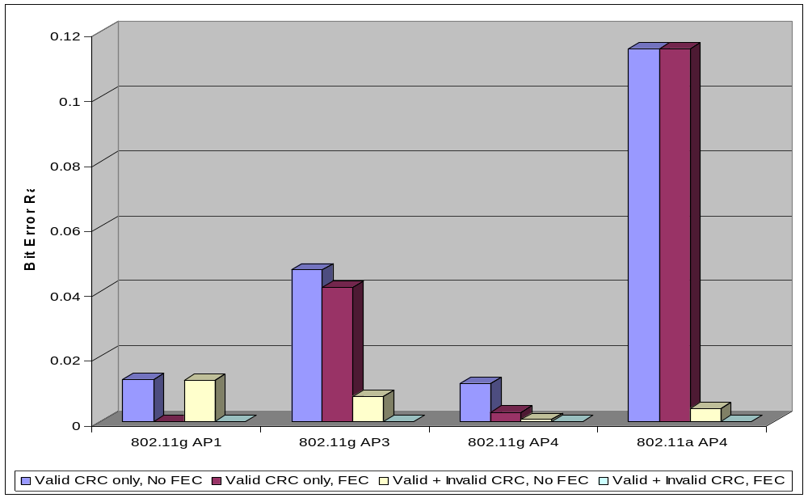
Do FEC, do not check CRC
Notes:
We have performed many tests with various access points in various homes. The graph on screen at the moment is an example of one test in one home. In the test we have 4 different access points and for each access point we assess the error rate when various transmission techniques are used. The first test is conventional IEEE 802.11 where any bit in error causes an entire packet to be dropped. The second test adds a forward error correction to the system used in the first test. The third test is based on looking at how many bits are in error in a packet. Note that this is non-standard 802.11 behaviour which required a special receiver that is able to pass packets in error to our software. The final test is based on adding forward error correction to packets with bit errors. The most interesting test is the fourth test because our tests produced error free video with one transmission with error correction coding, if packets with bit-errors are available to the receiver software.

Slide 33
Related activity outside 802.11
CEA R7 Home Network Group
IETF Audio/Video Transport (AVT) Working Group
    Specification of a protocol for real-time transmission of audio/video over unicast/multicast UDP/IP
    RTP/RTCP
ISO (MPEG-2/4)
ITU-T Video Coding Experts Group (VCEG)
DLNA uPnP
Other
  Video over cellular networks
  Video over DSL, cable, powerline, etc.
Notes:
Are there techniques/mechanisms in other 802 standards that we could use/adapt for 802.11?
Are there assumptions made in 802.3 that do not apply to 802.11 and hence cause performance degradation?
Is adherence to OSI layered model important? (QoS Management)
ITU-T, IETF, DLNA, …
We could just state that all video problems cannot be solved by 802.11. Video as an application must leverage solutions from other activities in addition to those from 802.11. If there are needs outside of 802.11, how should that be satisfied (is it even 802.11’s responsibility?)

Slide 34
Conclusions
Video is different from data; existing 802.11 mechanisms are not sufficient
The home networking industry at present is not planning to use 802.11 for video distribution!
  Instead, cable or powerline are being used
802.11 will be the medium of choice only if more is done in a timely fashion.
The industry is ready for 802.11 based Video Streaming NOW.
Notes:
Video does work fine in some specific scenarios. However, if video in the home environment were to be totally wireless (and match current TV experience) we need some 802.11 improvements (and possibly improvements outside of 802.11)

Slide 35
Some references
ISO MPEG2 standard and ITU equivalents H.261, H. 262, H. 264
HDMI
ITU-R BT.656 and BT.470-5
3GPP Techniques to transport sub-streams – Advanced Multi-Rate encoding, specifications 26.091 V6.0.0, 26.101 V6.0.0 and 26.102 v7.1.0, www.3gpp.org
TR-126 (http://www.dslforum.org/techwork/tr/TR-106.pdf)
MediaFlo, FloTM Technologies by Qualcomm
http://www.compression.ru/video/quality_measure/index_en.html
There have been a number of 802.11 WNG presentations, 11-05-0910-01-0wng, 11-06-0039-01-0wng, 11-06-0360-00-0wng contain more references
Notes:
There have been a number of wng presentations

Slide 36
Backup
Notes:
This material will be used only if there are questions that require a detailed discussion.

Slide 37
Video Characteristics
 | Mean Bit rate, M (kbps) | Peak Bit Rate, P (kbps) | P/M | Compression
 |  |  |  |  | Min | Max | Avg
Die Hard-III | 697 | 3392 | 4.9 | 10.9 | 2122 | 165970 | 41193
Jurassic Park | 766 | 3349 | 4.4 | 9.9 | 2005 | 144344 | 46747
Silence of the Lambs | 575 | 4448 | 7.7 | 13.2 | 2841 | 216000 | 34029
GOP Size (bytes)

Slide 38
11n use cases: application specific details (doc.: IEEE 802.11-03/802r23)
Application | Offered Load (Mbps) | Protocol | MSDU Size (B) | Maximum PLR | Max Delay (ms)
SDTV | 4-5 | UDP | 1500 | 5*10^-7 | 200
HDTV (Video/Audio) | 19.2-24 | UDP | 1500 | 10^-7 | 200
DVD | 9.8 peak | UDP | 1500 | 10^-7 | 200
Video Conf | 0.128 - 2 | UDP | 512 | 10^-4 | 100
Internet Streaming video/audio | 0.1 – 4 | UDP | 512 | 10^-4 | 200
Internet Streaming audio | 0.064~0.256 | UDP | 418 | 10^-4 | 200
VoIP | 0.096 | UDP | 120 | 5% | 30
Notes:
This table is copied from Table 4 - Application Definitions, pg. 11

Slide 39
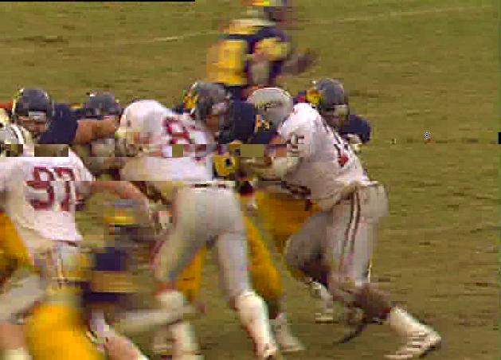
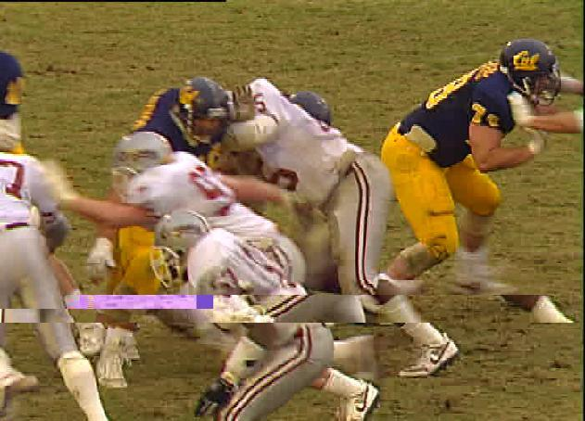
Packet Loss: Not all packets are born equal
Single B-frame IP packet loss
(1 frame affected)
Single I-frame IP packet loss
(14 frames affected)
Furthermore the loss of an IP packet can mean the loss of a PES header or a loss of a timestamp at the TS or PES layer. The worst case for losing an IP packet causes loss of 0.5 seconds worth of video.
Source – TR126, www.dslforum.org
Notes:
[AA: There are also issues at higher layers than the video frame level. For example, a loss of an IP packet can mean the loss of a PES header or a loss of a timestamp at the TS or PES layer.]

Slide 40
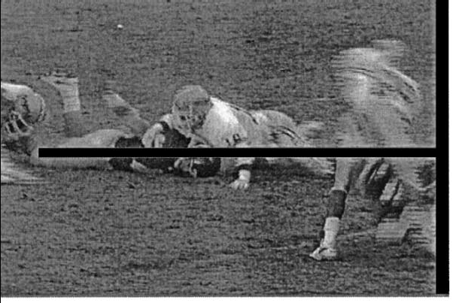
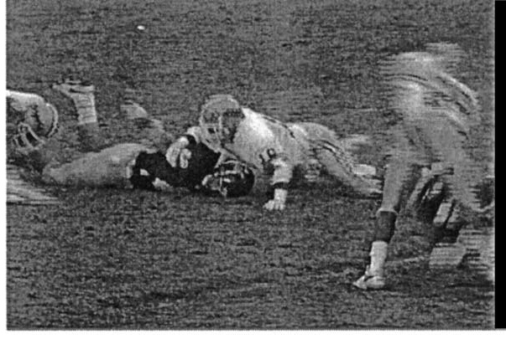
Error Concealment at the renderer
No Error Concealment
Error concealed using a simple average of Macro Blocks around the region corresponding to lost data
From “Error Concealment Techniques for Digital TV by Jae-Won Suh and Yo-Sung Ho, IEEE TRANSACTIONS ON BROADCASTING, VOL. 48, NO. 4, DECEMBER 2002, Pages 299-306.
Notes:
Need some pictures to demonstrate this
Encoder assisted –
(a) Data Partitioning
(b) adding tags, watermarks, etc to the encoded data that the renderer can key-on
(c) retransmissions by the sender
Encoder independent –
(a) Replace missing data from the last rendered frame or by averaging patterns around the missing block

Slide 41
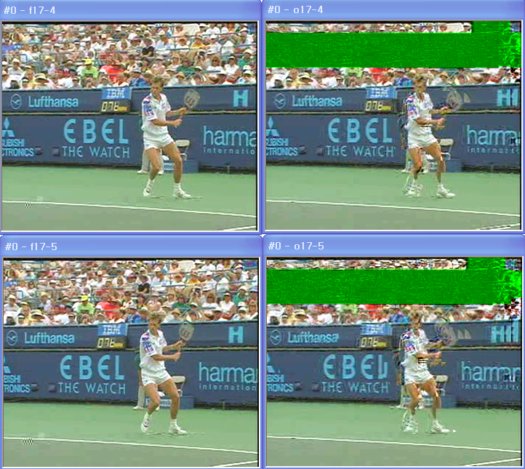
Resiliency to bit errors

Slide 42
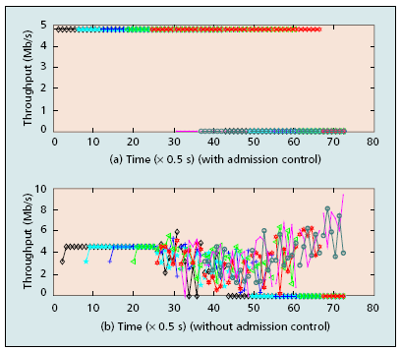
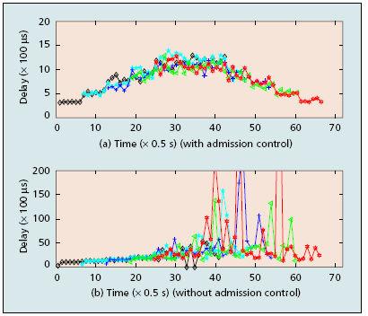
Limitations in Current 802.11 Mechanisms (QoS + EDCA TSPEC Admission Control)
Throughput variation
Delay variation
From “Evaluation of Distributed Admission Control for the IEEE 802.11e EDCA by Yang Xiao and Haizhon Li, University of Memphis, IEEE Radio Communications, Pages S20-S24”
Notes:
Why is current 802.11 not meeting the requirements of streaming applications?
Demonstrate with simulation, real-life measures and references to literature how 802.11 mechanisms do not meet streaming needs.
Provide an idea of what is needed
If available suggest how current mechanisms could be improved or newer mechanisms can augment current ones to make 802.11 streaming friendly
Mention that data from .11n is hard to come by
Provide an idea of what is needed
Maybe add a slide that emphasizes that TSPEC computation accuracy is important
Mention that Admission Control -- EDCA TSPEC Admission

Slide 43
QoS policy needs to be dynamic
Establishing QoS contract with QoS parameters
Monitoring the established contract
  Channels may changing
  The behaviour of admitted streams can change
Based on the monitoring, the capability to take appropriate actions should be provided
A good service may offer tiered QoS, for gradual degradation.
  e.g. the transmitter may support variable bitrate output
There may be multiple content contributors.
  Cable TV provider may be responsible for video delivery
  Telco may be responsible for Telephony
  Consumer may have purchased the home networking infrastructure
Notes:
* Channel conditions are dynamic
* What happens if the channel condition does not provide the bandwidth that was originally available when the stream was admitted
Monitor the channel and apply a policy accordingly in order to guarantee video performance.
Inter-Layer communication

